Slide 1
Picture Books 101 Think Like a Child. Write Like an Adult
SCBWI-SWTX June 25, 2016
Charlotte Sullivan Wild

Slide 2
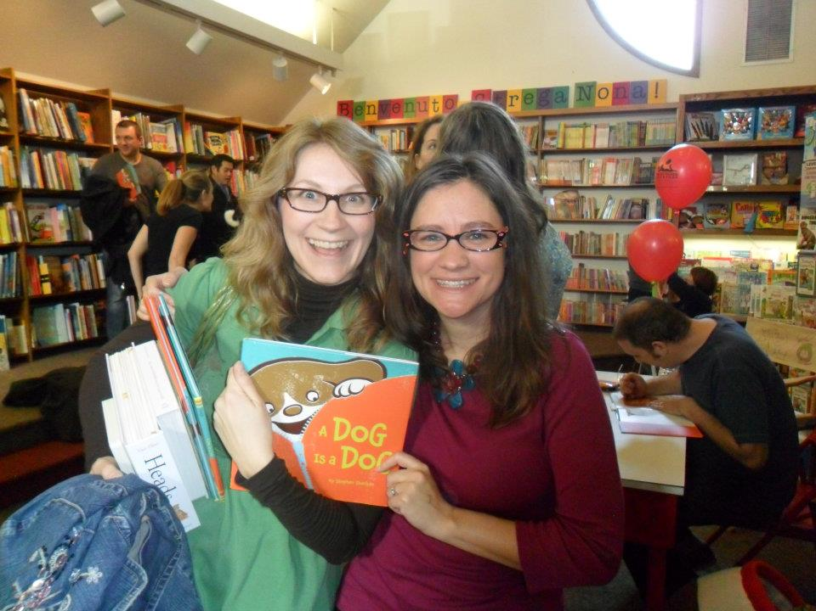
Why picture books?
(Everyone thinks they can write one…
maybe this weekend…)

Slide 3
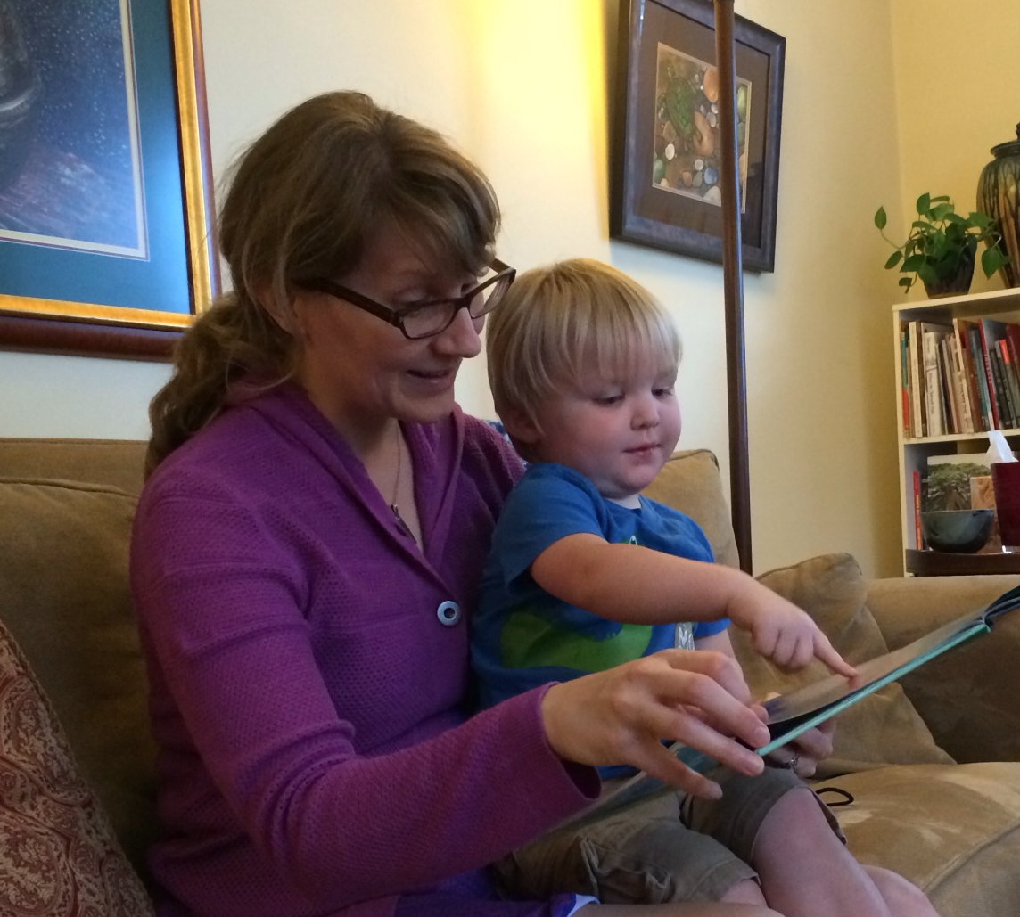
Because of this…

Slide 4
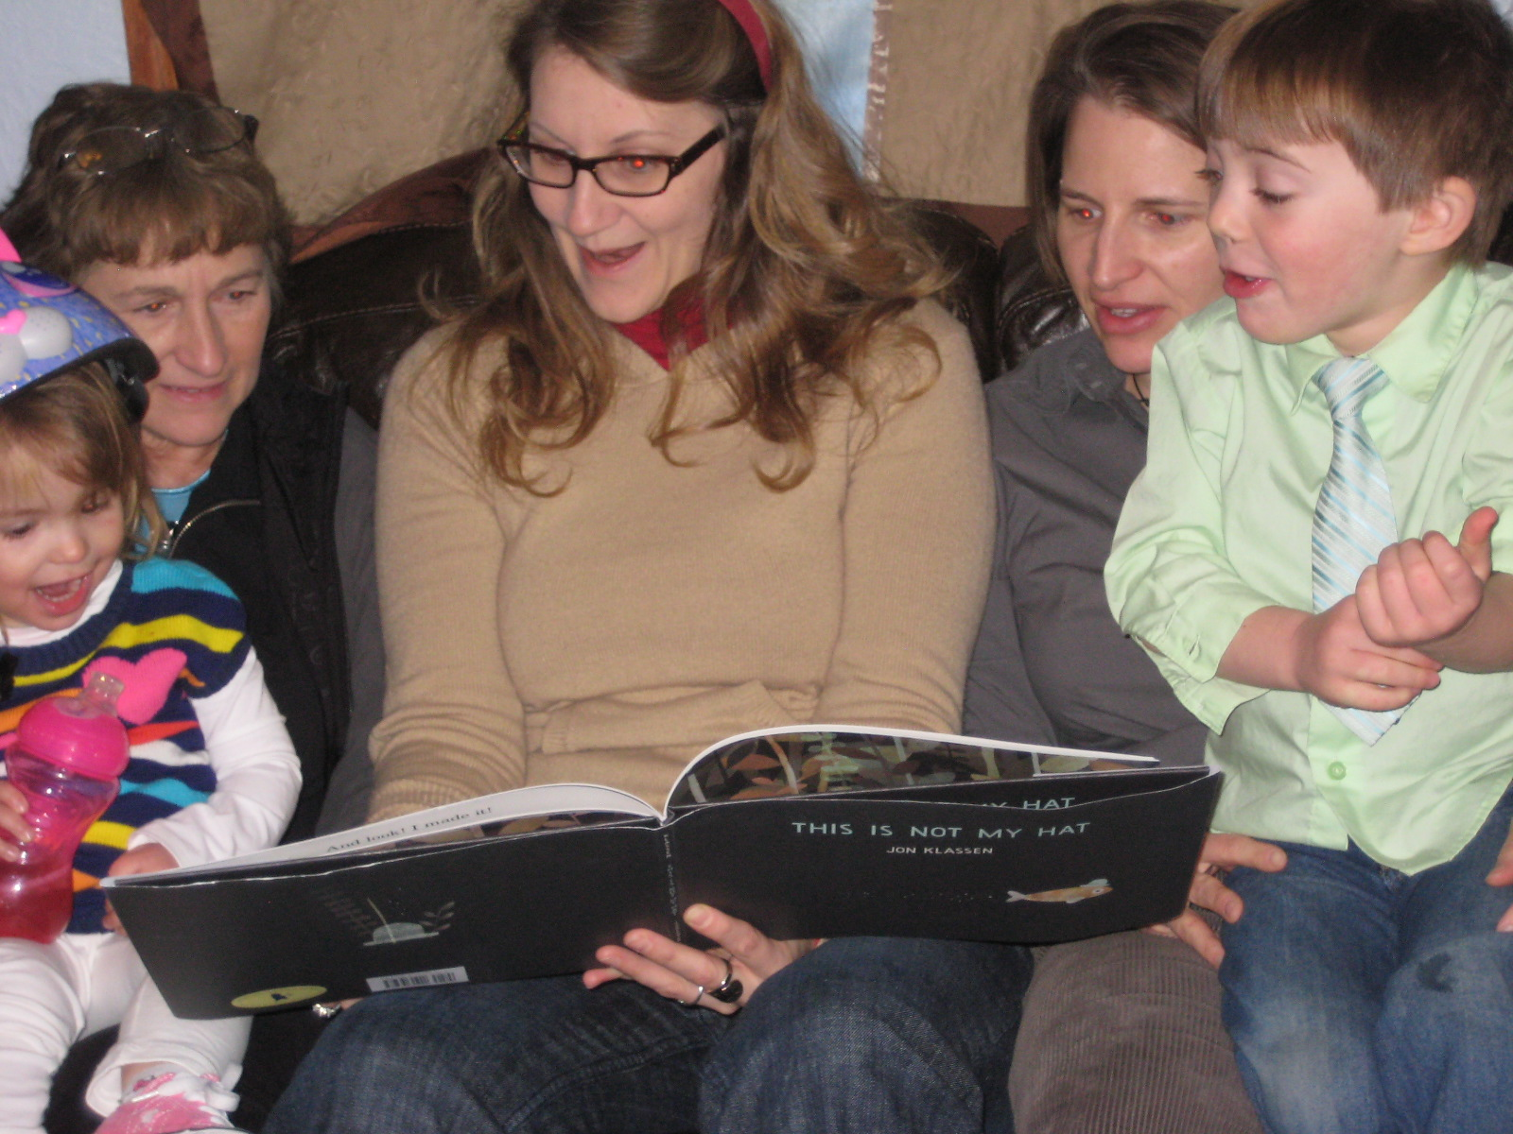
…and this…

Slide 5
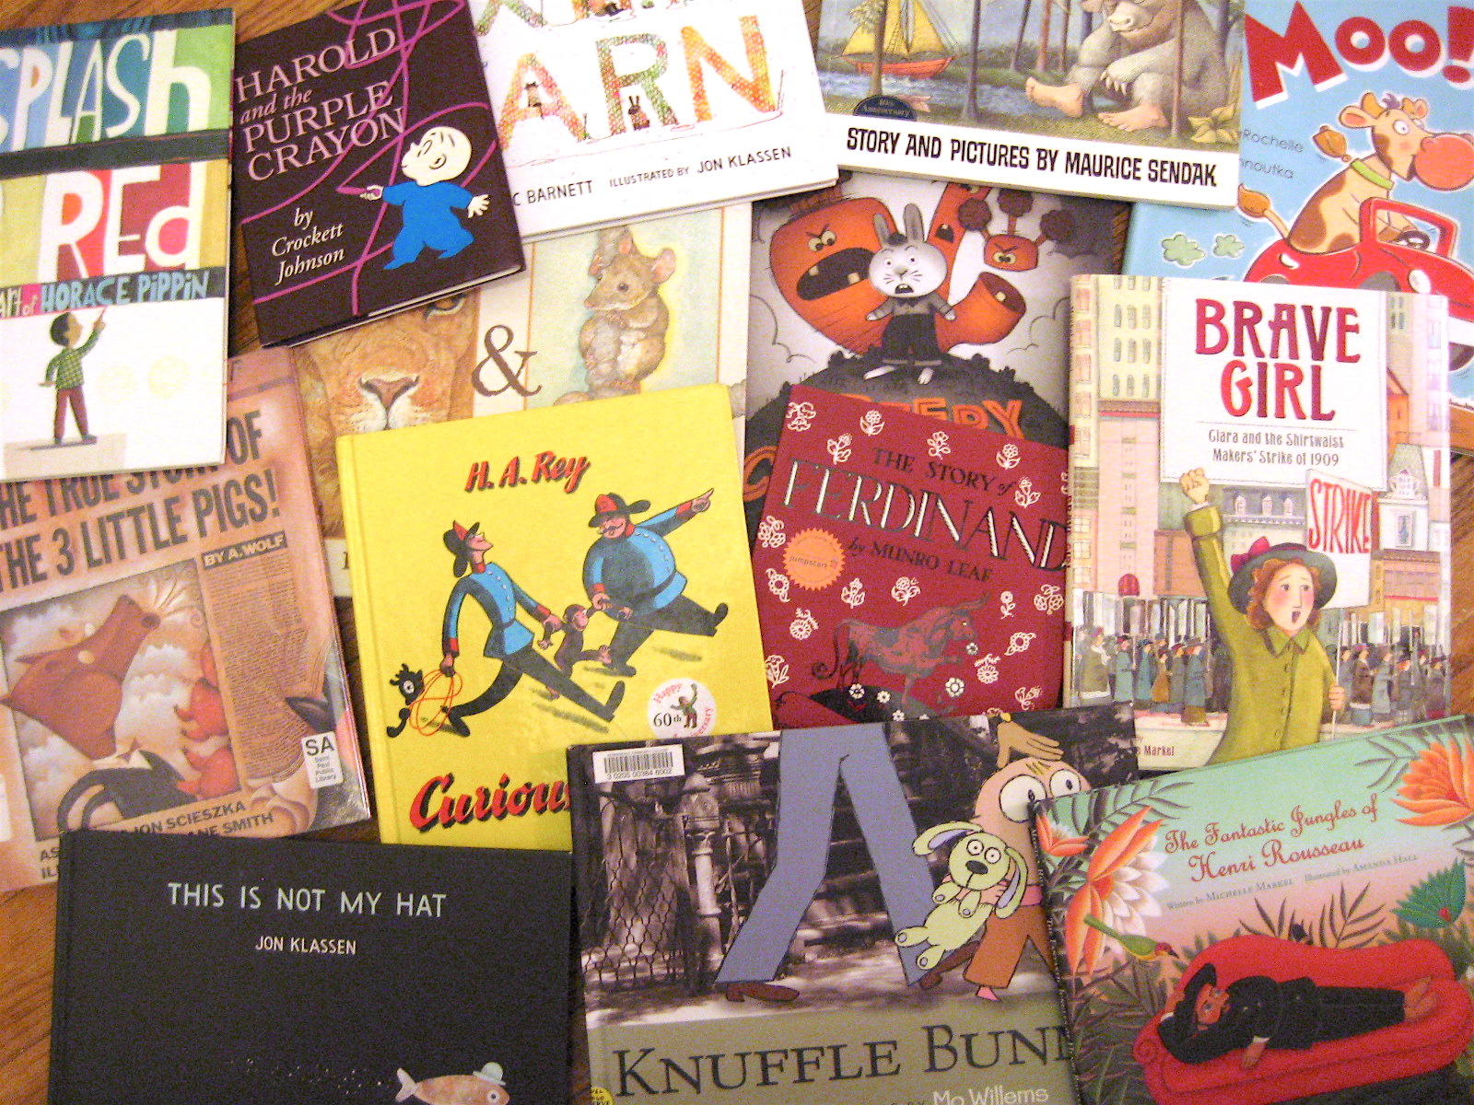
…and (insert your favorites!).

Slide 6
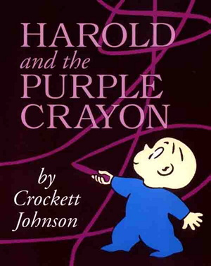
Picture books are unique…
Performance Art
Poetry
Narrative
Collaborative
Restrictive in content & form
Flexible, include many genres

Slide 7
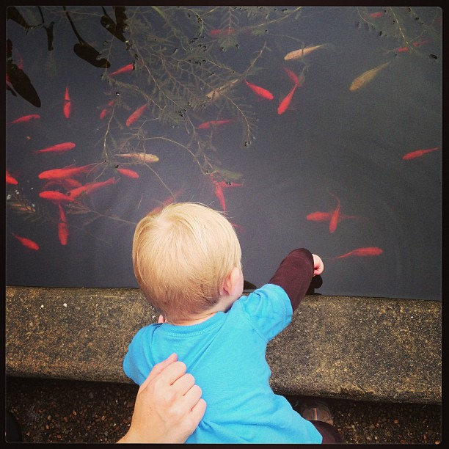
What do you see?

Slide 8
Revisn REVISION: Finding Your Story’s Heart
(Without loosing heart)

Slide 9
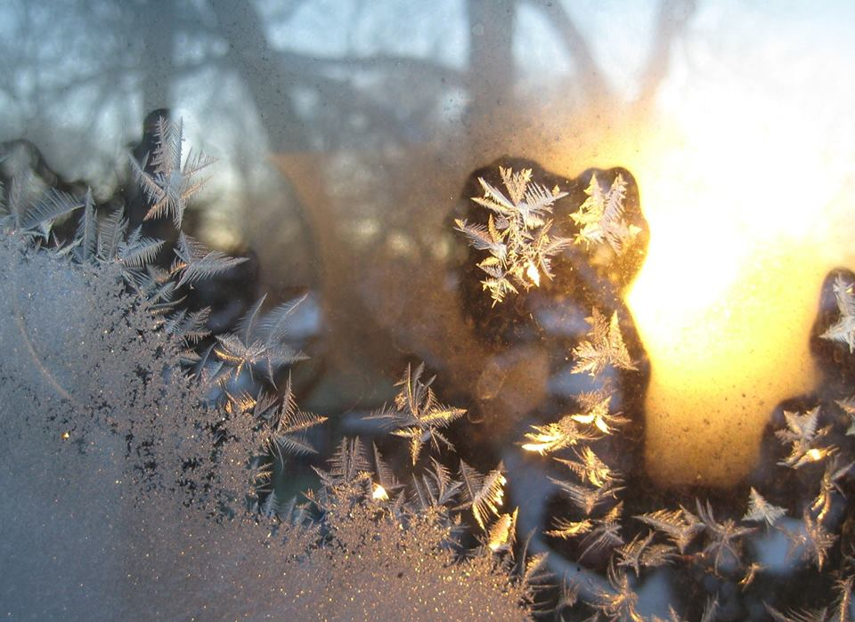
How do you move from that first SPARK….

Slide 10
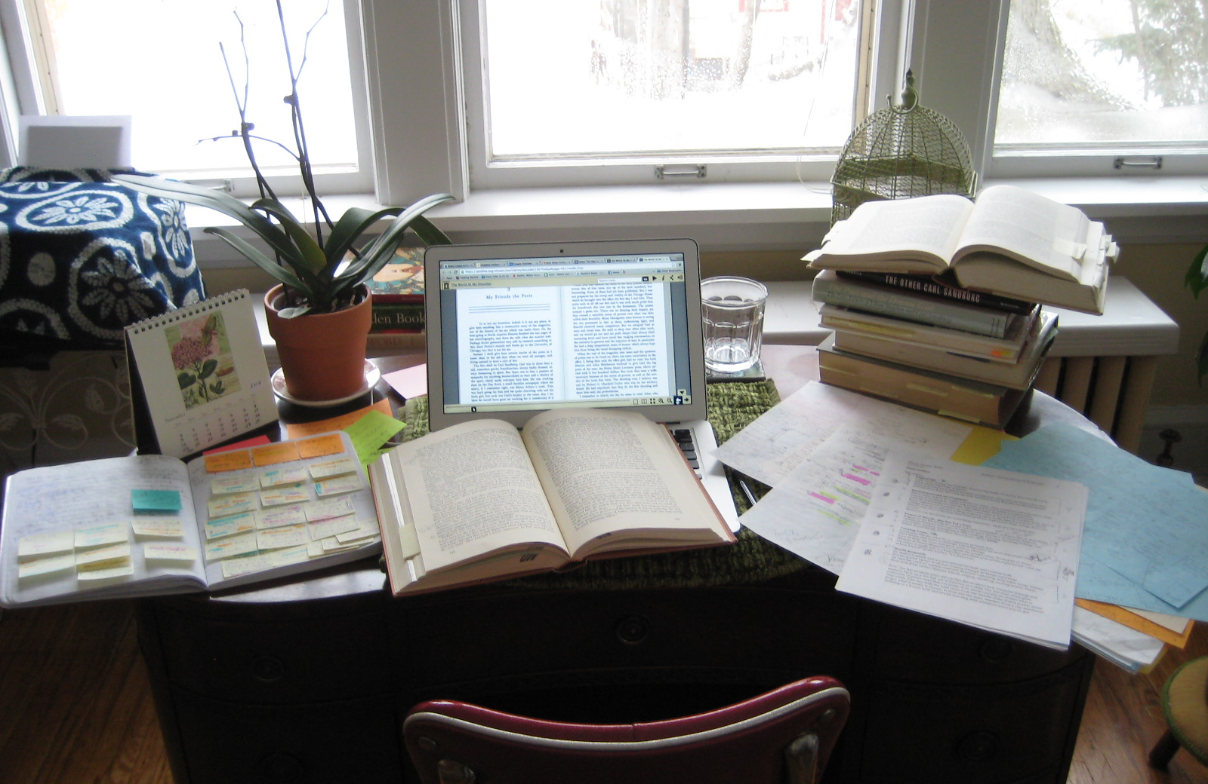
through the mess…
(Unless you’re one of those PERFECT people…)

Slide 11
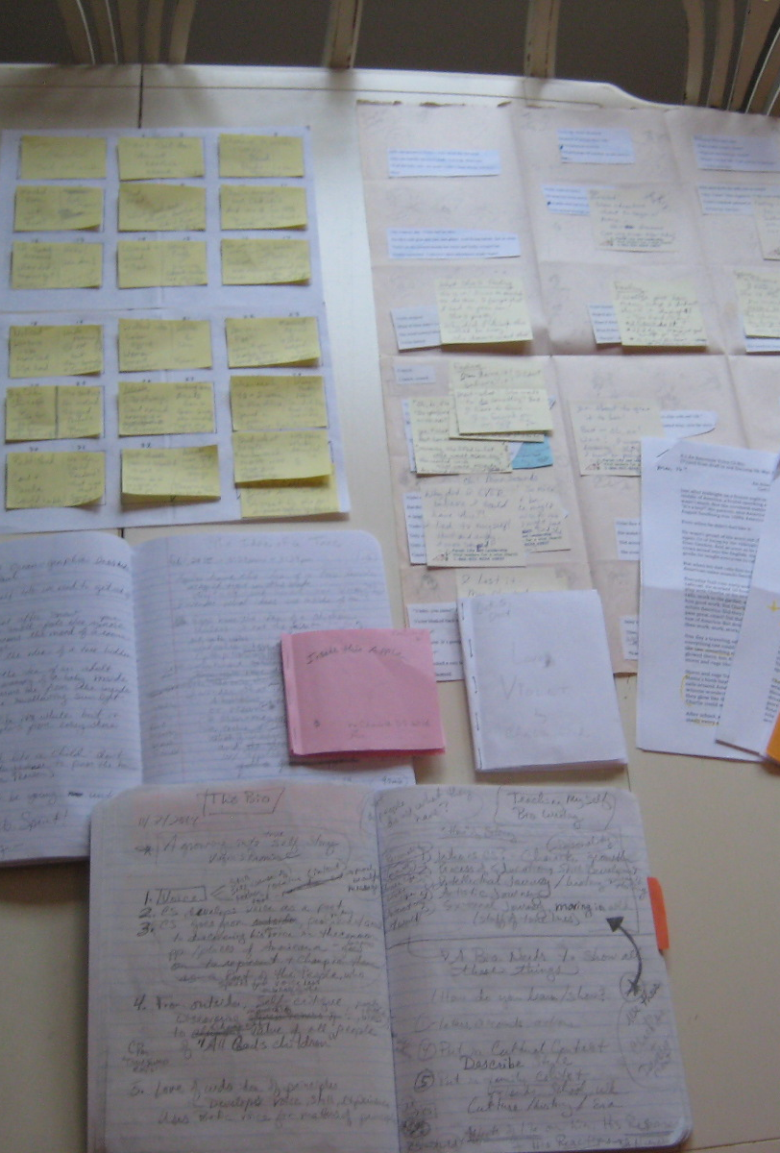
And more mess…
(this could take awhile)

Slide 12
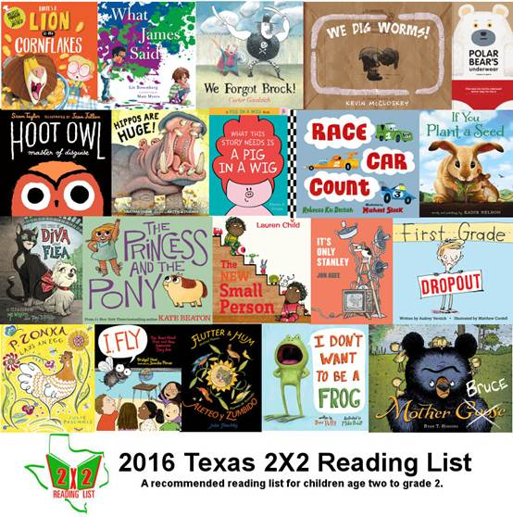
To this?

Slide 13

By finding the heart of your story.

Slide 14
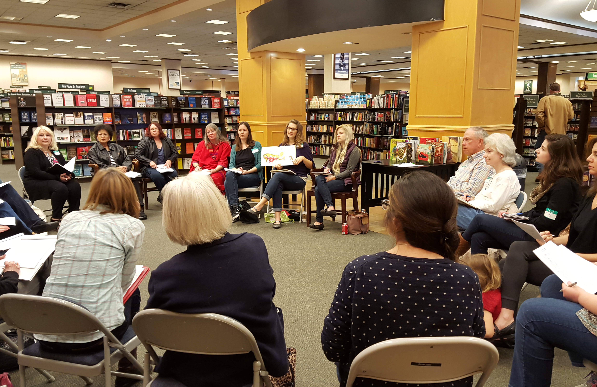
And with help!
Lots and lots and lots of help.

Slide 15
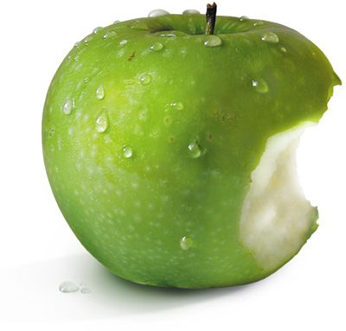
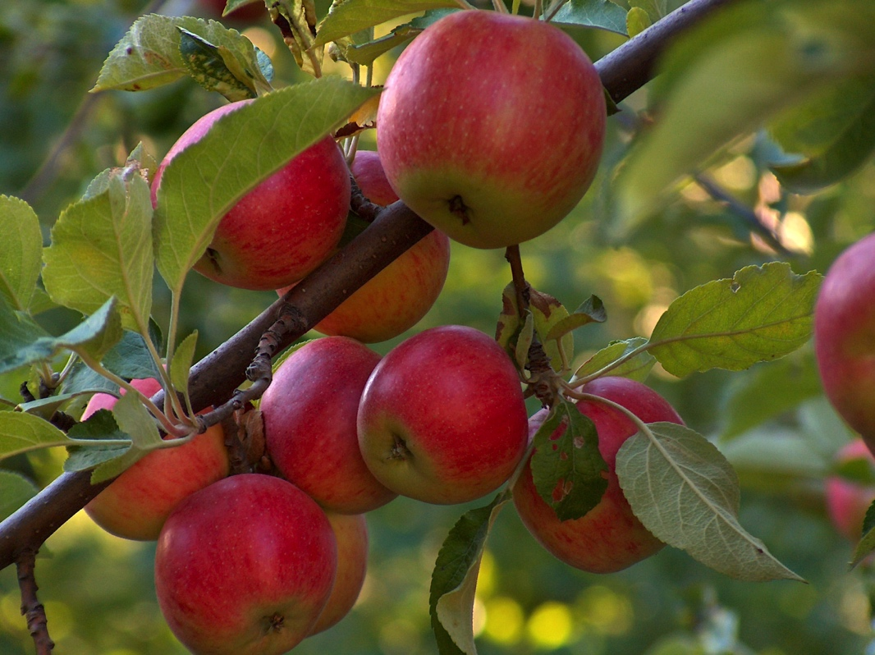
Writing is writing is writing…
No matter the project
—fiction, nonfiction, concept book— the process is apples and apples.

Slide 16
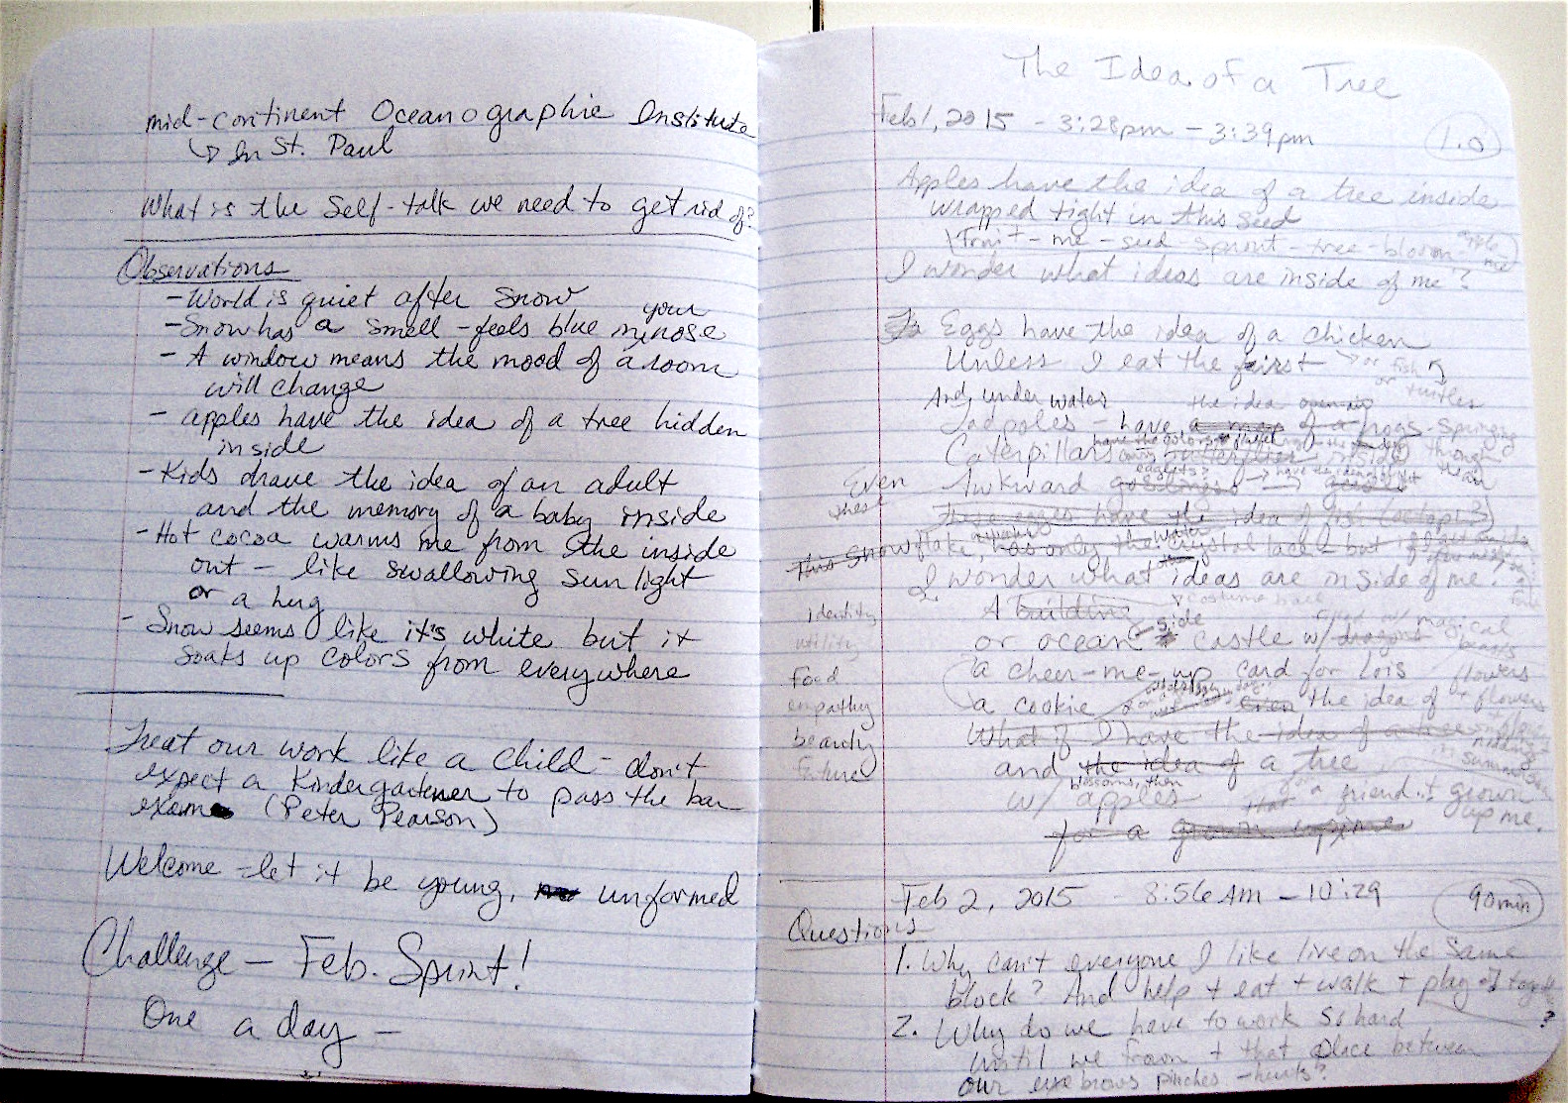
It begins with a mess…

Slide 17
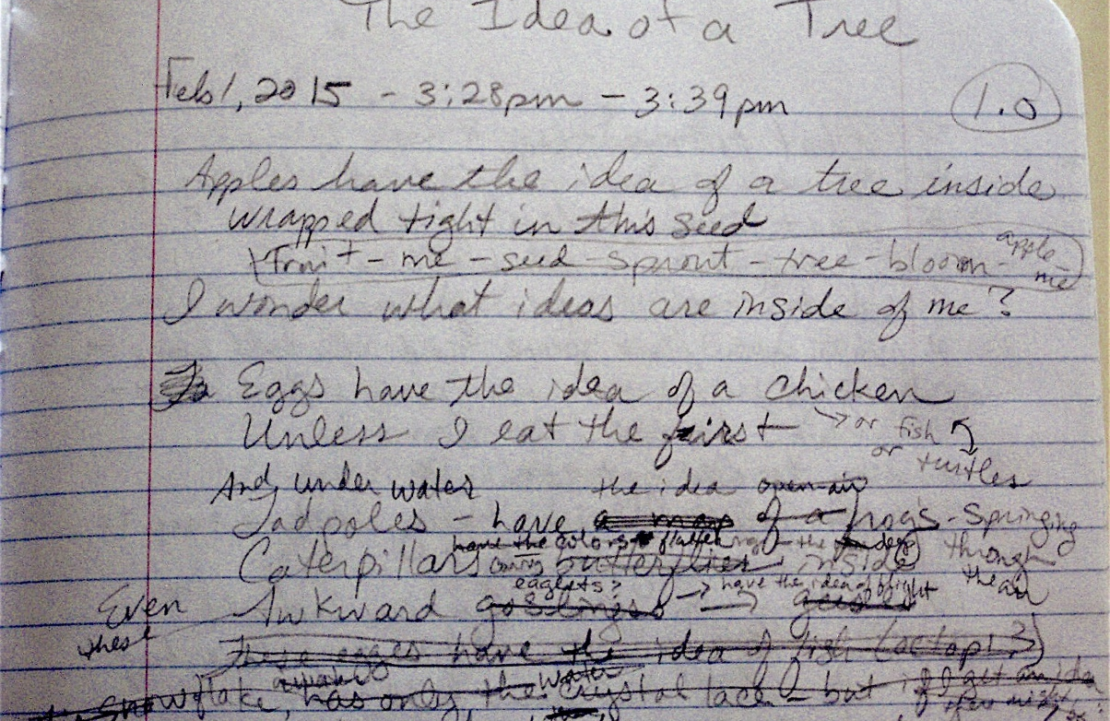
What is it? Search for your…
Character (Fiction)
Heartbeat in the Facts (Nonfiction)
Concept (Concept)

Slide 18
Find the ONE THING
…this is about.

Slide 19
Every detail, every scene, every line…
Supports that ONE THING.
Check.

Slide 20
Check beginnings/ endings
Once upon a time…
ONE THING clear in both?
((HEART/ CONCEPT in line #1?
Character/ concept INVITING?
World/ genre CLEAR?))
ENDING relate to the BEGINNING?

Slide 21
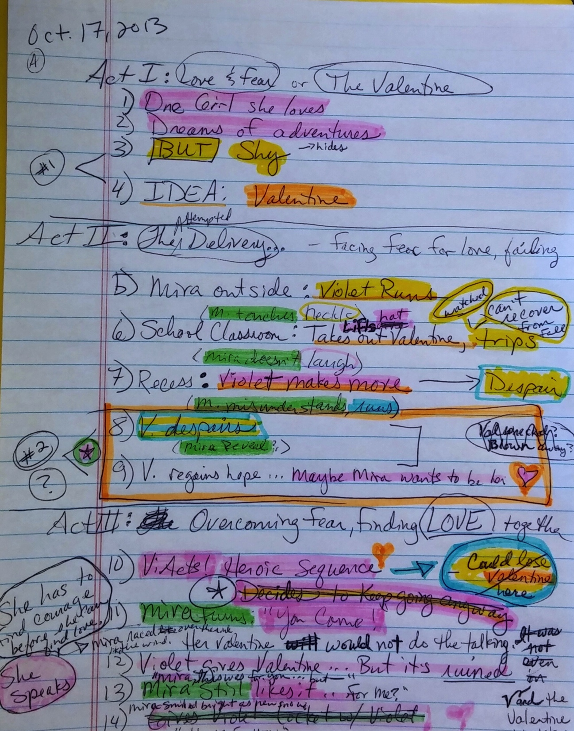
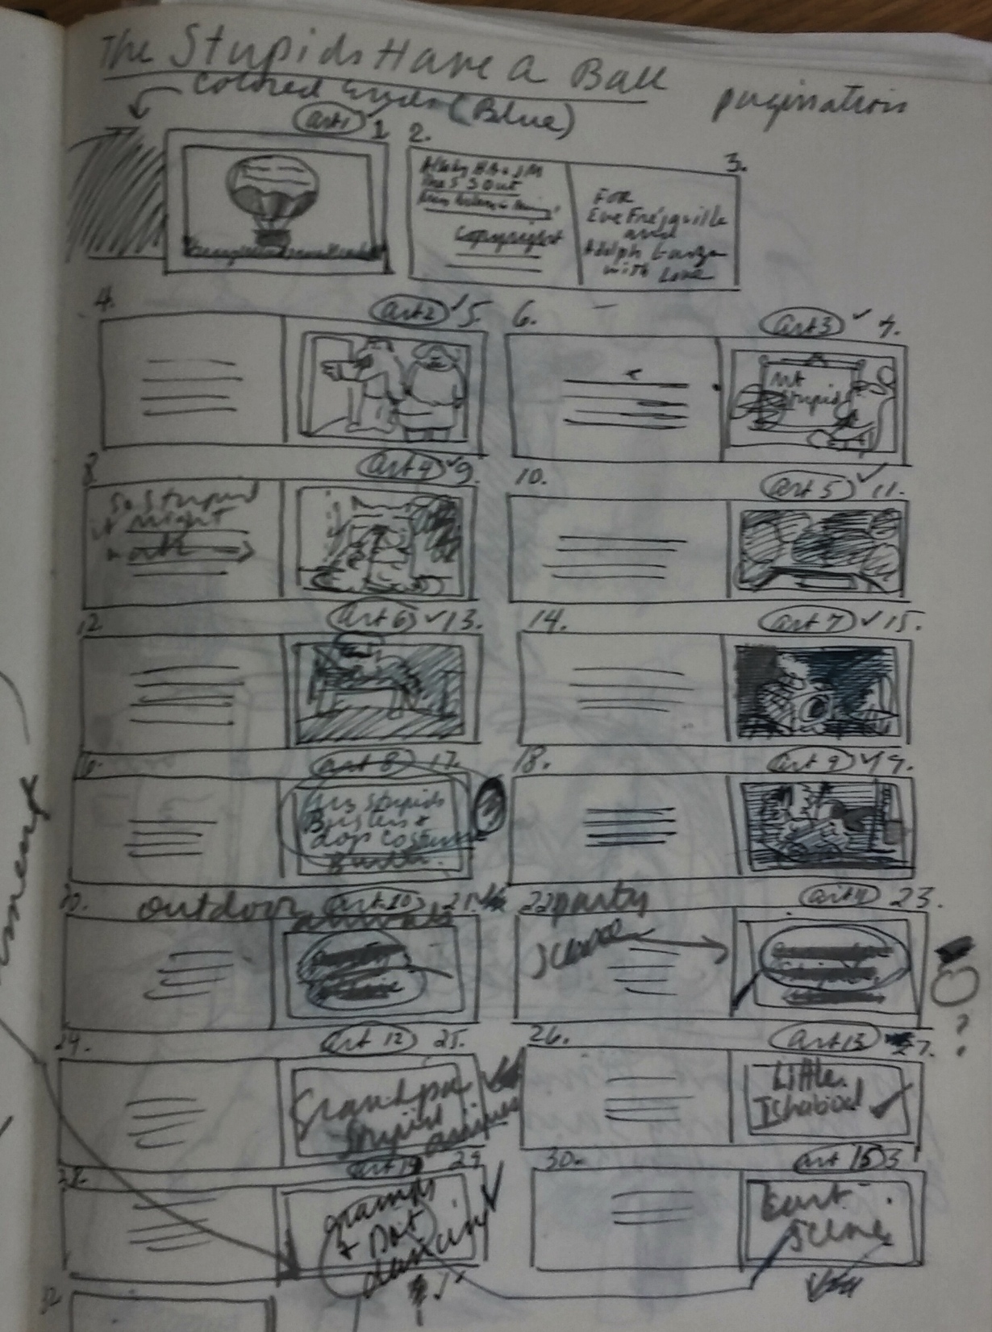
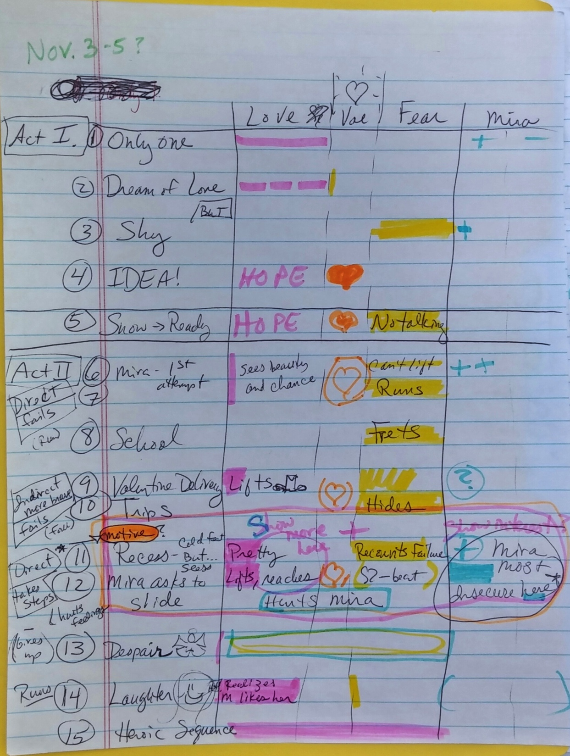
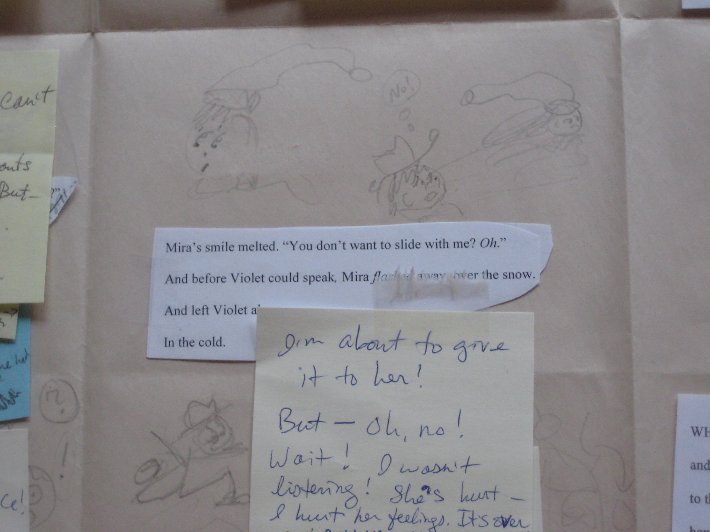
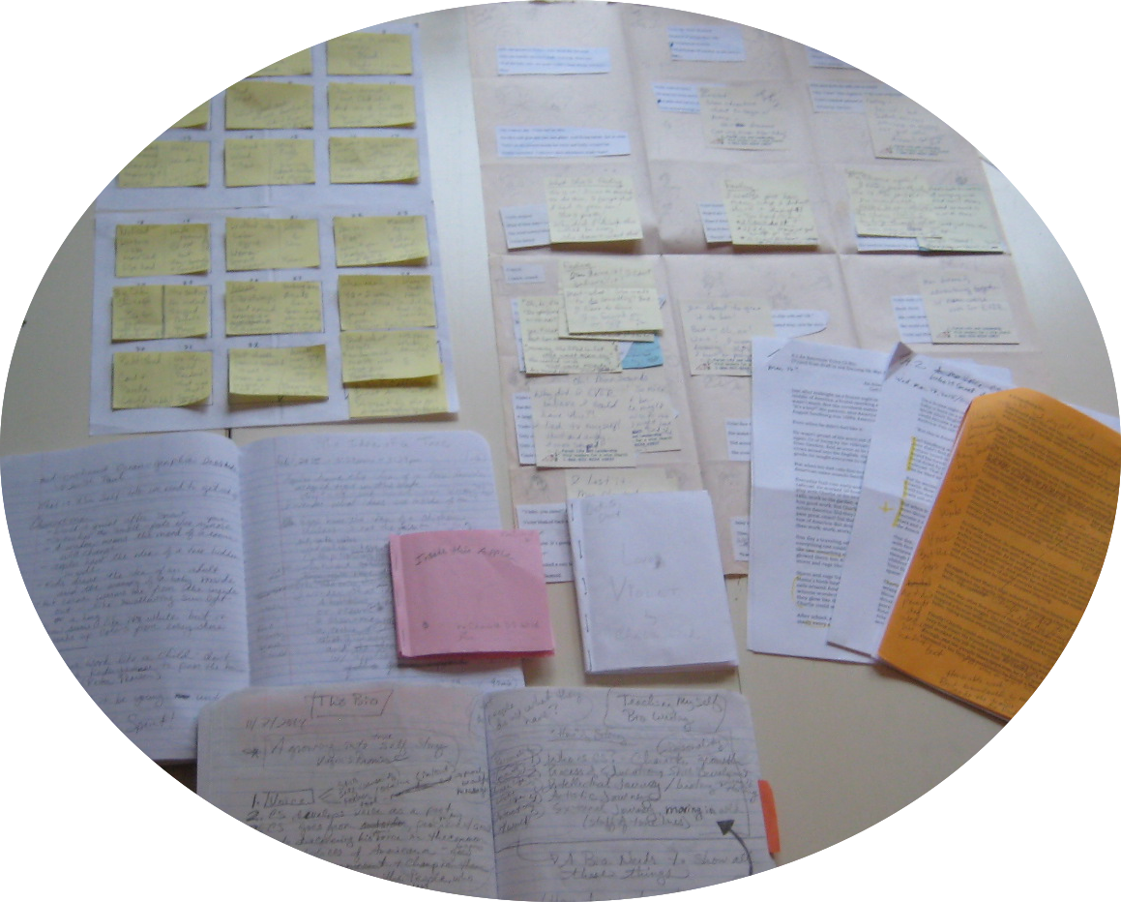
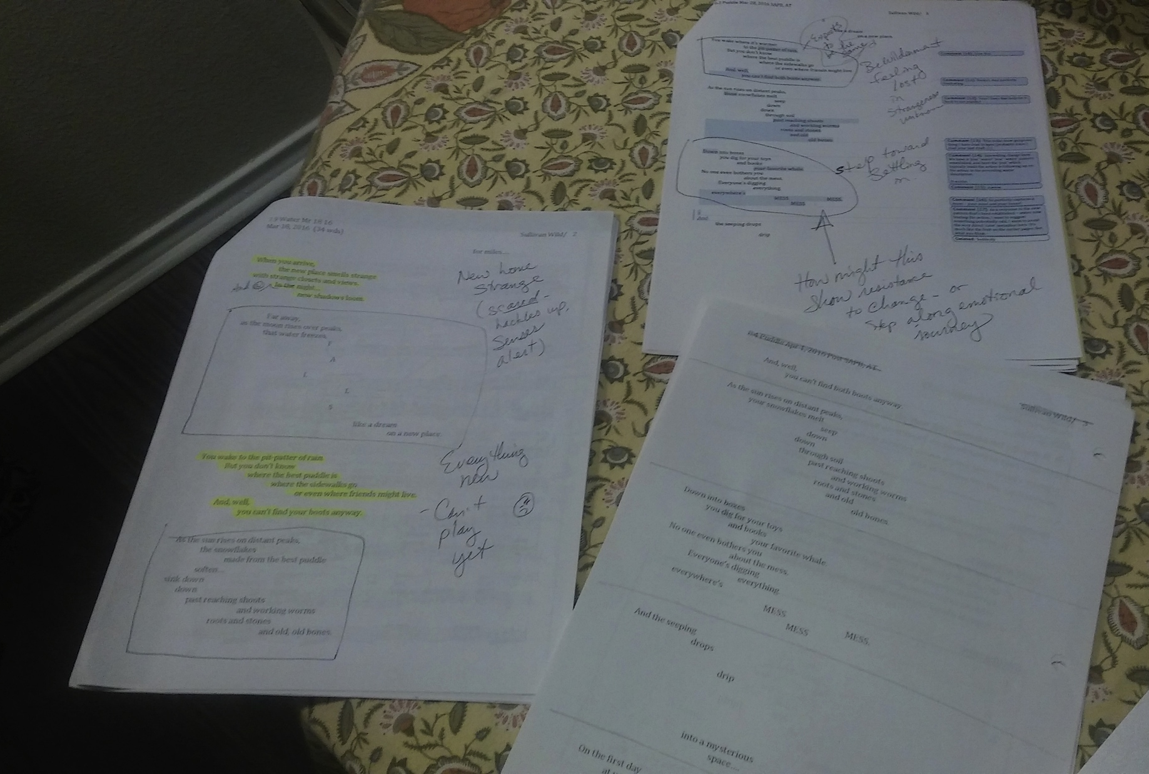
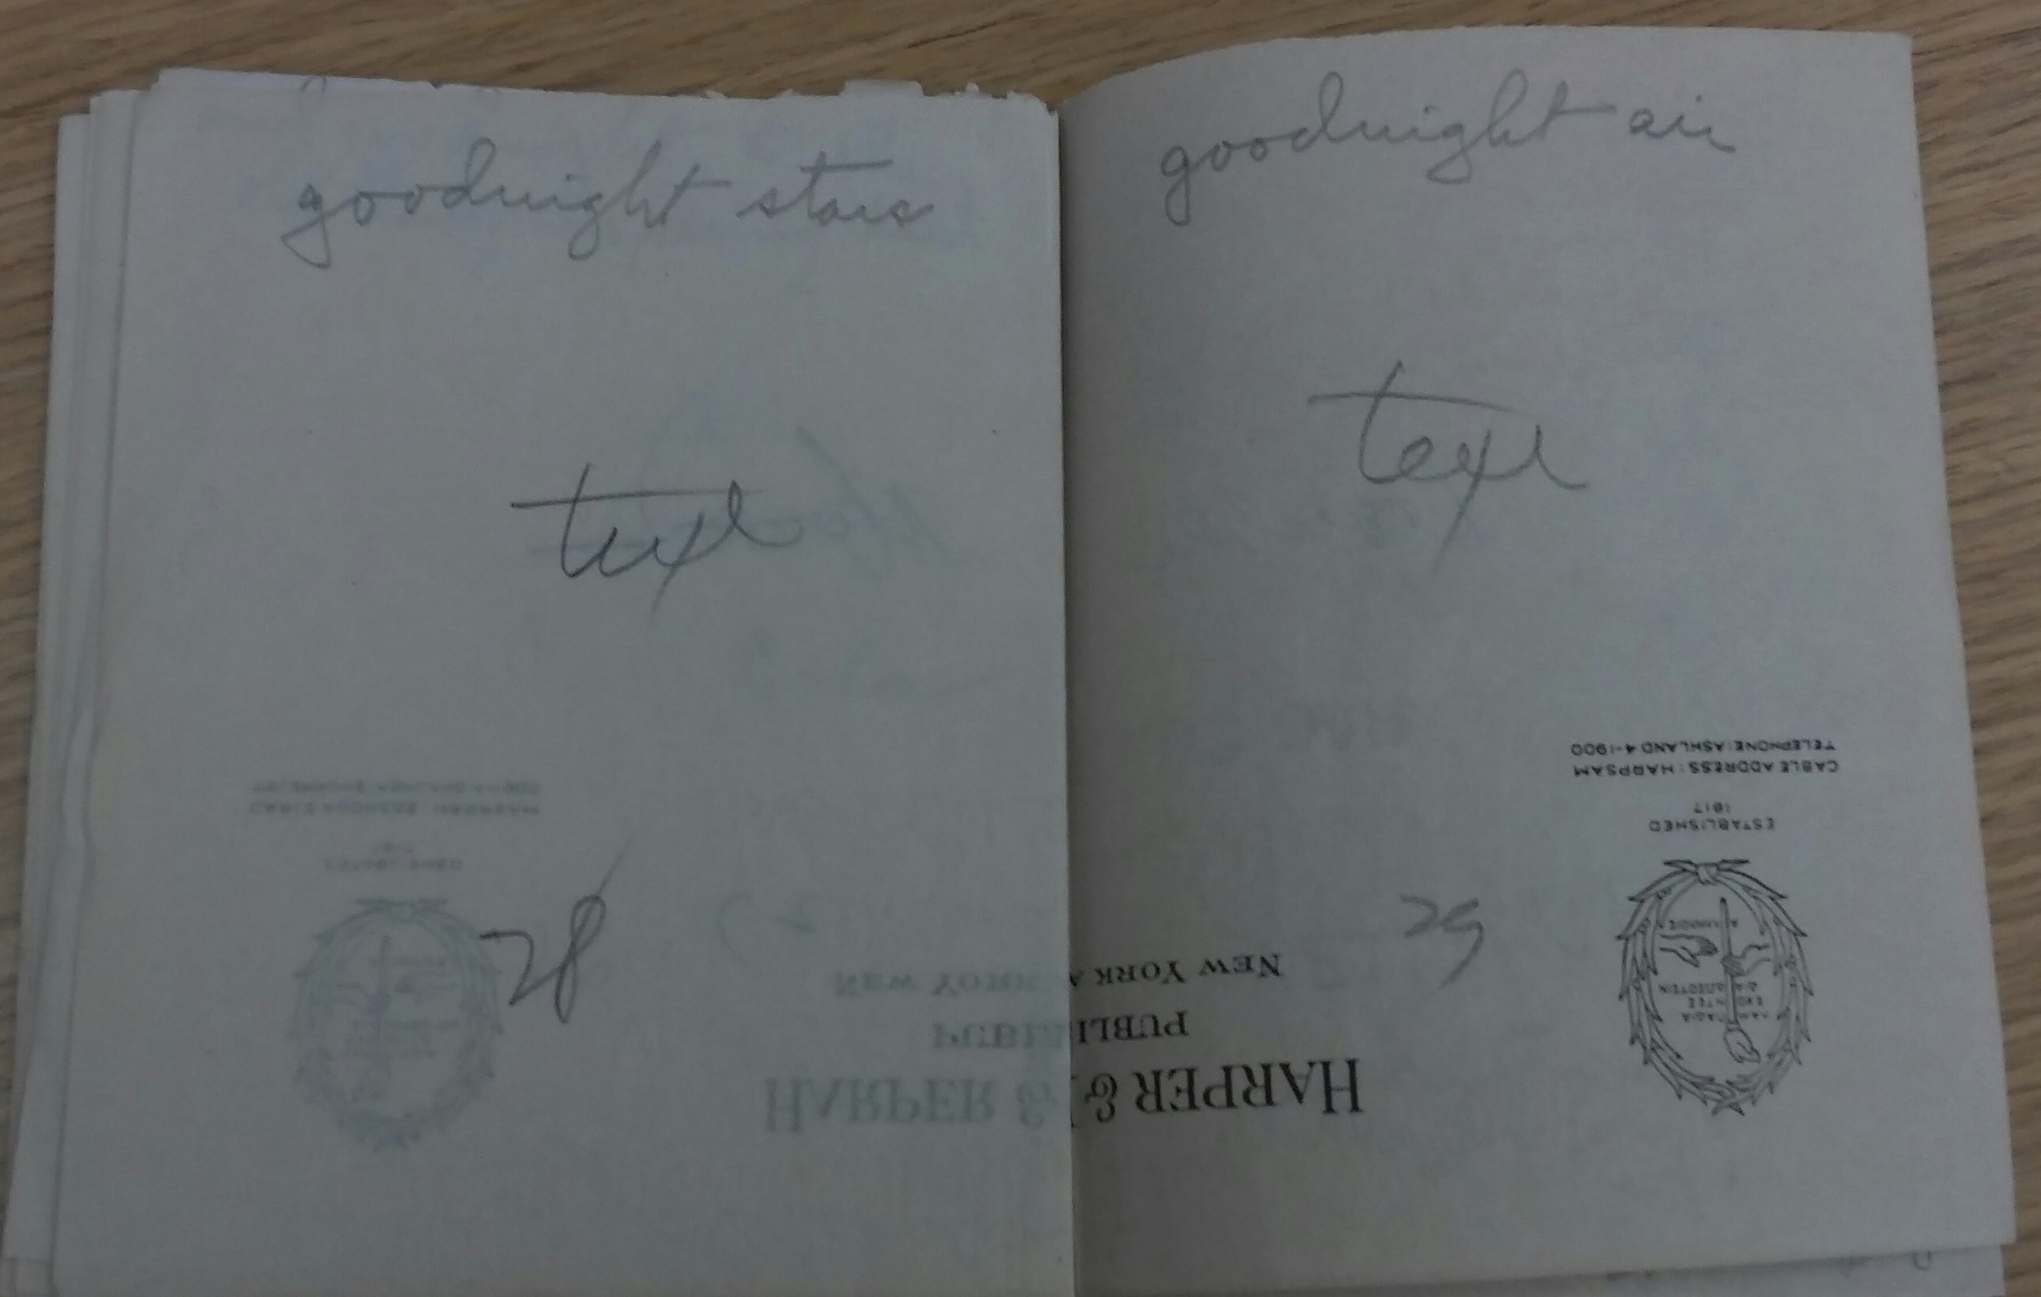
Tricks for SEEing

Slide 22
Find ways to SEE your work
Feedback!
Open mind v. vision
If readers “don’t get it,”
Is vision on the page?
Are comments RE expectations or execution?
Use Your Own Tricks
Outlines
Dummies
Charts
Labels on mss
Rainbow highlighters

Slide 23
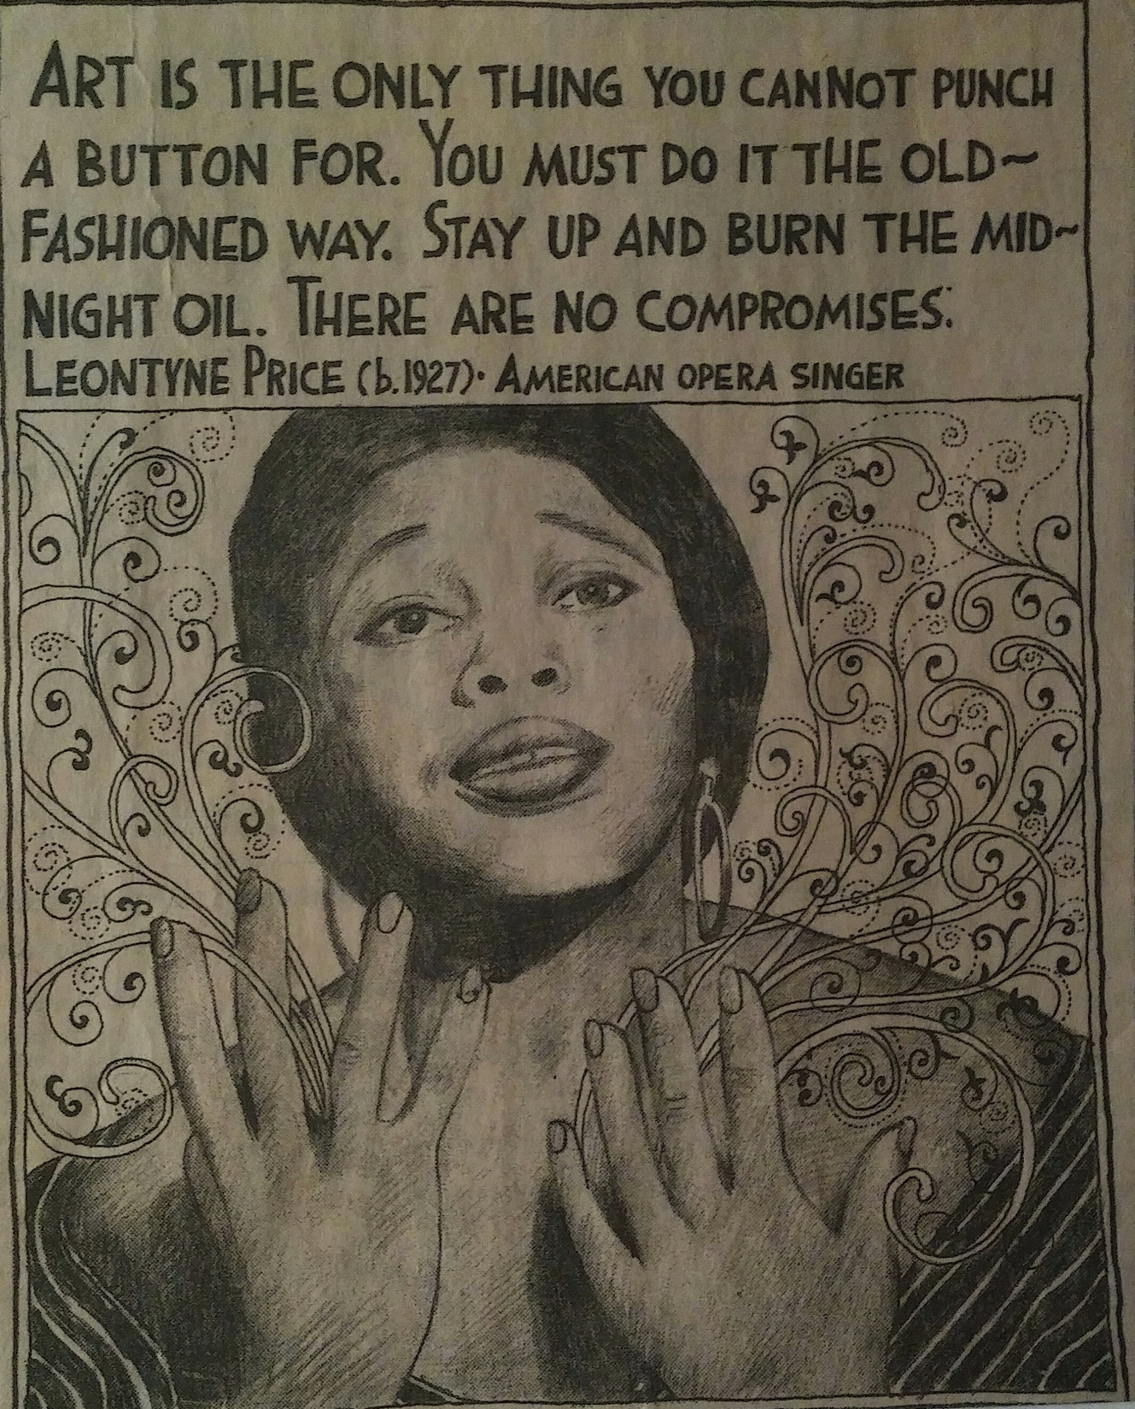
Truth
L. K. Hanson
StarTribune May 4, 2009

Slide 24
Writing a Story?
Who is my character?
What’s the desire?
What’s the problem?
What’s the struggle?
What does the character do?
How does the ending reflect the character AND the heart of the story?

Slide 25
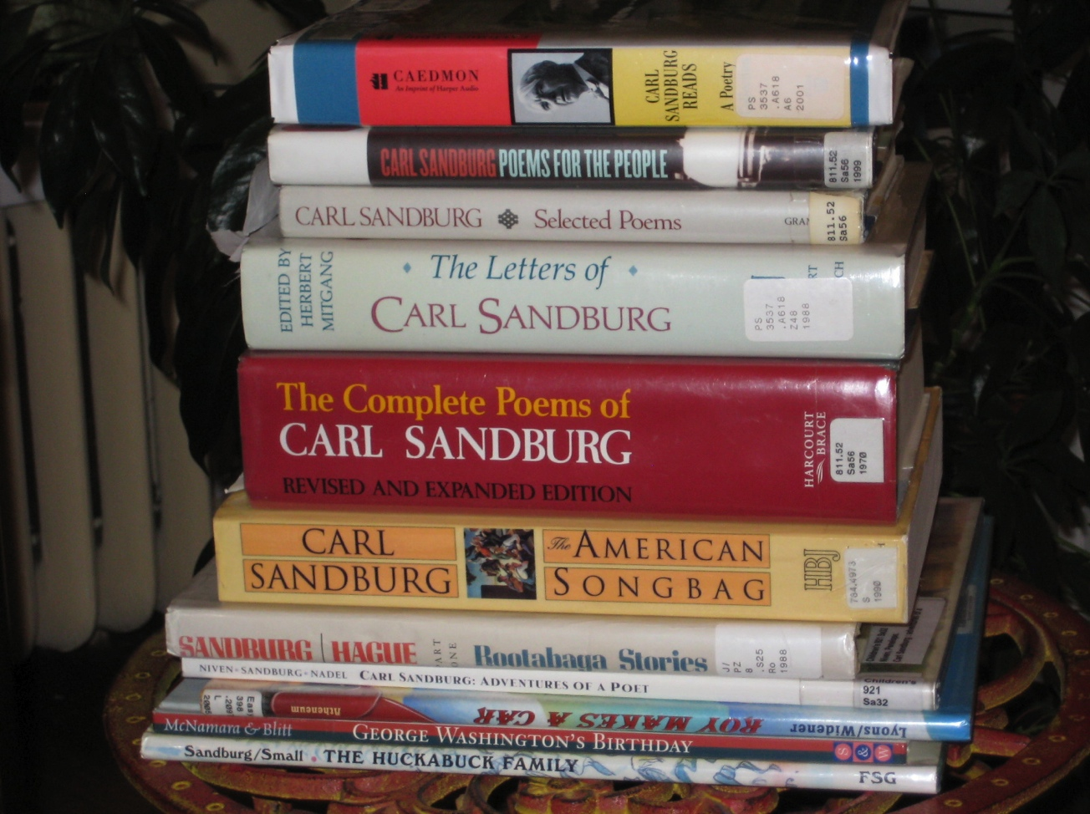
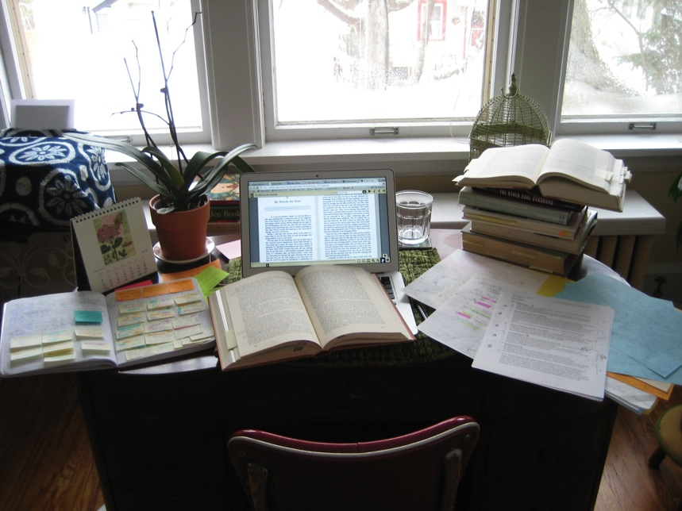
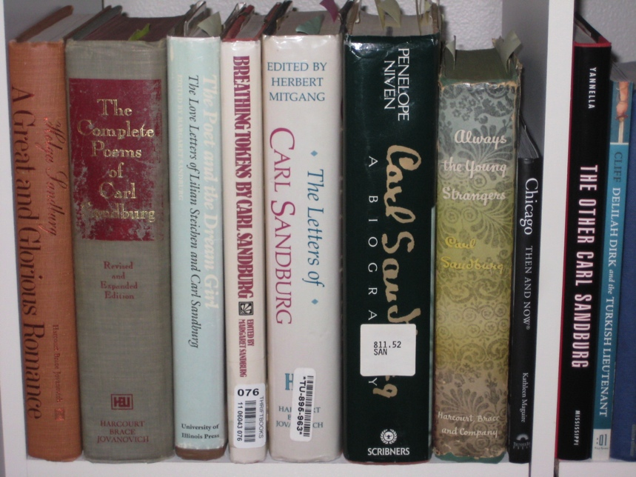
Writing Nonfiction? Let the treasure hunt begin!

Slide 26

Too much! Now what?

Slide 27
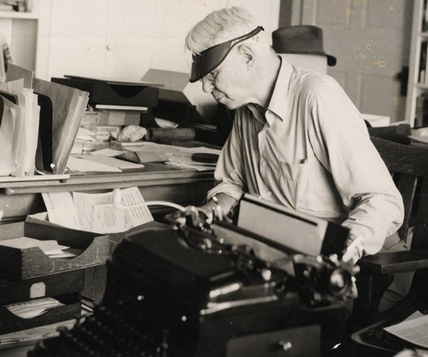
“Biography is hell.” Carl Sandburg
Scroll
…this is memory— sometimes slurred and blurred— …sometimes wrecking the images and proceeding again to reconstruct what happened and how, the many little involved answers to who? what? when? where? and more involved than any how? how? ~Carl Sandburg

Slide 28
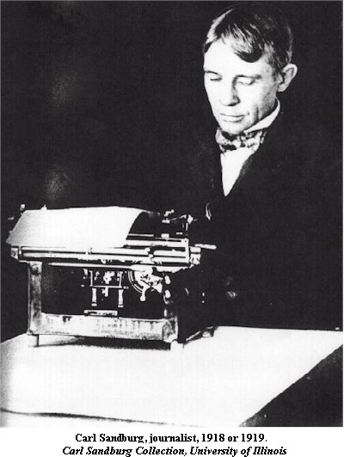
Look behind the facts…
Work like a fiction writer.
Biographies:
Not what, but why?
Research / draft toward a thesis
Character’s heart
Story’s scope and arc
Informational books:
What’s interesting to a child?
What makes it meaningful as a whole?

Slide 29

Heart of the character & story
“Henri Rousseau wants to be an artist.”
(Despite ridiculous obstacles.)
“Why? Because he loves nature.”
~Michelle Markel

Slide 30
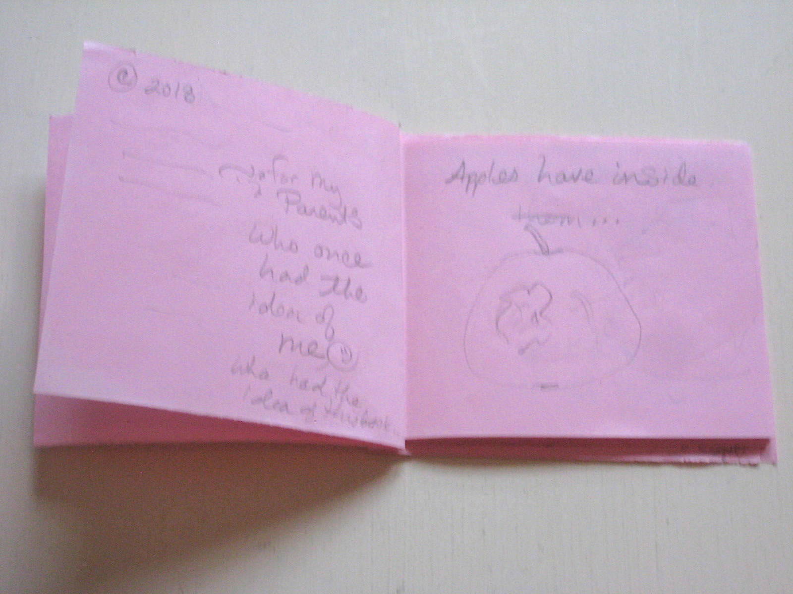
What is my concept?
Fiction:
Who’s my character?
What does she want?
What’s in her way?
What does she DO?
Concept:
What does concept include?
How is it more than a list?
Why is it meaningful?
How does its meaning grow throughout the ms? The Quiet Book or WATER NOISE

Slide 31
INSIDE THIS APPLE
Hidden in this apple And look at you!
is the idea of a tree What ideas are hidden
wrapped tight inside of you?
in this shiny seed. A new song
Take a bite, drop a bit no one has ever heard?
the idea might take root
sprout Or maybe
shoot up on a chill drizzly day
into the blue inside you will grow
And in the nest the idea of a tree.
curled inside the egg So you dig
waits the idea of a bird drop a seed—
And all the songs
she’ll ever sing... Soon an orchard teems...

Slide 32
Examples of Choices
Feedback:
What ideas are inside you?
Art?
Card for Lois?
Idea of friend after fight?
Feedback:
How do nature/ kid sections relate?
How do we transition?
Question:
What is the CONCEPT?
“Tree inside apple”
Potential, small to big
General/ universal
How can I make the book MORE LIKE ITSELF?
Mirrored kid/ nature
Added transitions
Added detail to orient reader

Slide 33
Truth
L. K. Hanson
StarTribune May 4, 2009

Slide 34
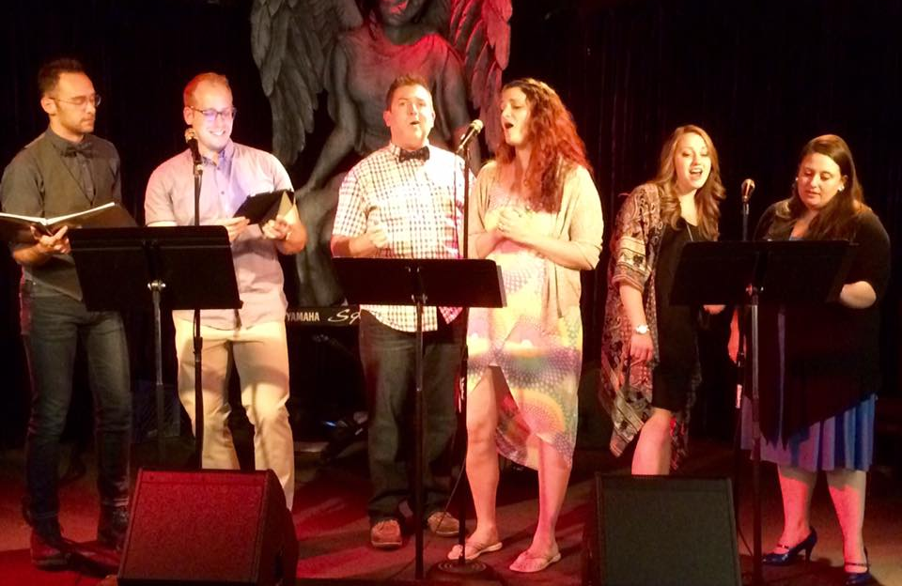
9. Remember why we write…

Slide 35
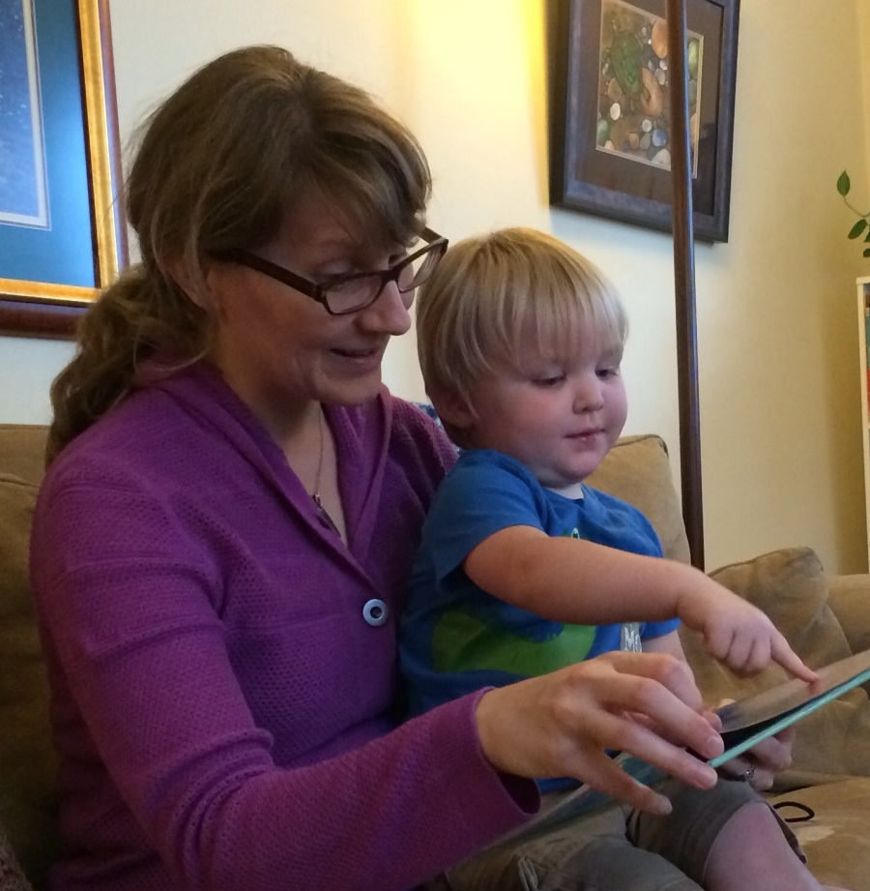
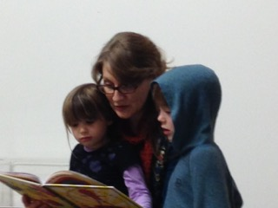
To connect with another heart
(Not to be perfect, get rich, look smart, get on Oprah. Her show’s over, kid. Give up that dream…for something better!)

Slide 36
Resources!
SCBWI, chapter meetings, conferences, website
Picture Book Salon of SA
The Writing Barn (Austin)
The Loft Literary Center (MN, but with online classes)
Highlights Foundation
MFA Programs (Vermont, Hamline, others)
What else?

